Slide 1

The Picard
Abdalrahman Afifi, Hunter Lavender, Travis Mueller, Zachary Wildasin

Slide 2
Problem Statement & Background
Developed by Dr. Tom Devine from West Virginia University
Establishes a virtual cluster of machines to run the experiments while efficiently processing large data sets
PICARD's frontend user interface will be web-based, allowing for secure monitoring and remote control
Visualizations will provide hardware usage statistics, significant findings, data analysis, and real-time updates during execution
Security is crucial for the PICARD's success, so every aspect of the system will be securely configured and maintained

Slide 3
Goals and Objectives
Create an intuitive User Interface to interact with the Platform for Intelligent Computer Algorithm Research & Development
Replicate a form to build custom commands and parameters for each experiment
Allow users to save results locally from each experiment
Have users to authenticate through email & password
Each user will be able to see results from previous experiments

Slide 4
System Architecture
Linux Ubuntu based server with 2 Intel Xeon gold 5218 processors
Nodes are creating using docker
Apache Spark for distributed data processing
Connected with database through Firebase cloud
The User Interface is bootstrapped with ReactJS

Slide 5
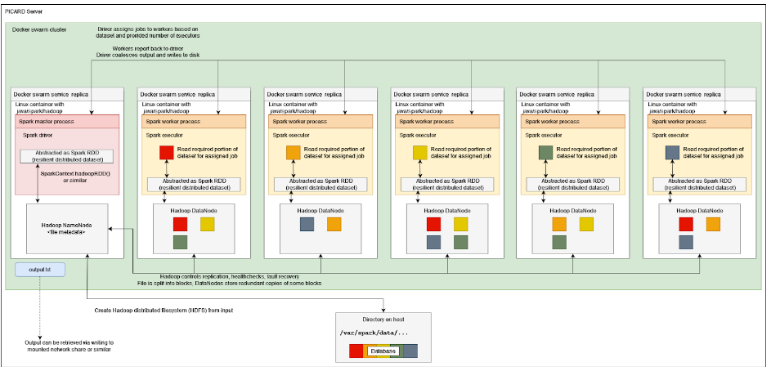
System Architecture: Docker Swarm
This system diagram provides a visual representation of the docker swarm clusters
Our user interface constructs these commands to send to the server
Then docker swarm spins up instances to read data set
Credit: Group 11 CSEE 481 Spring 2023

Slide 6
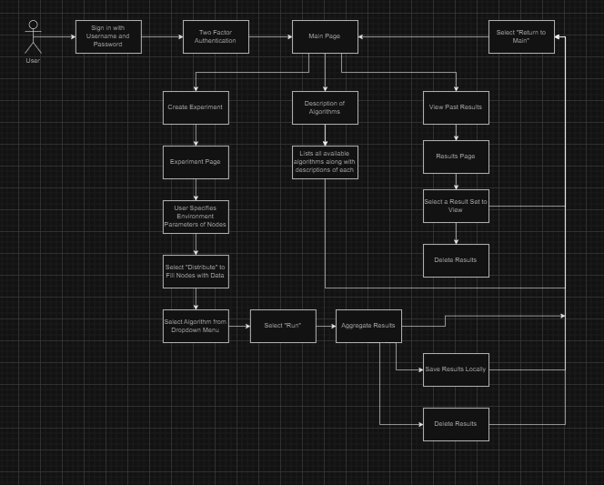
Front End Diagram
Front End Diagram designed last semester
Implementation derives from this along, additional requirements added
Video Demonstration of the full user interface is later in the presentation

Slide 7
Highlights of Technologies and Innovative Ideas
The PICARD’s innovative approach to implement a simple way to define parameters for algorithm research
Utilization of cloud technologies
Distributed Computing
Docker Containers

Slide 8
Accomplishments
Full functional user interface
Functional UI implemented with the ability to construct parameters for experiments
This includes complex parameters for the user to specify their computational needs
Ability to install application on additional hardware
Application and dependencies can be easily installed with having the application run on a docker container

Slide 9

System Demonstration

Slide 10
Suggestions for future development
Spend an extended amount of time going through documentation from previous semesters
Develop contingency plan for when issues arise
Implementation of complex visualization tools to enhance user’s understanding of data
Recommendation of deploying to cloud

